Slide 1
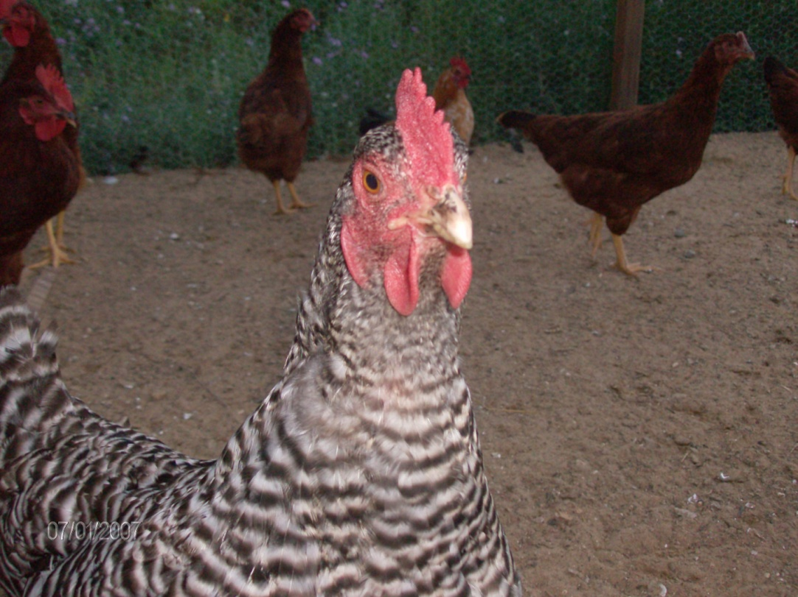
Jan’s Morning
By: Shannon Haines

Slide 2
Jan’s day began like all others.
First she woke up
and stretched her wings.

Slide 3
Then she started her morning walk.

Slide 4
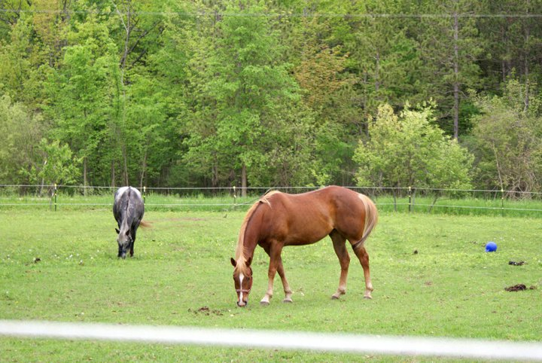
She strolled through the horse corral.
“Hello Maverick
and Teddy”.
“Good morning, Jan.”

Slide 5
The next stop was to see the goats.
“Good morning, Billy and Blaze.”
“Good morning to yourself, Jan.”

Slide 6
Next came the calf pen.
“Good morning, Holly.”
“Lovely morning, Jan.”

Slide 7
A bit farther down the line were the pigs.
“Good morning, Patty.
Greetings, Link.”
“Fine day, Jan.”

Slide 8
The last stop was the new alpaca.
“Good morning Buzz. How are you doing this fine day?”
“First rate, Jan! I’m starting to love this place.”

Slide 9
With all of her farm friends greeted, Jan headed back to her coop.

Slide 10
She found all of her chicken friends awake.

Slide 11
“Beautiful morning ladies. Ready to get to work?”
“Cluck! Cluck!”

Slide 12
The End

